Slide 1


.NET MAUI: Part 2: MVVM & Data Binding
James Montemagno
Principal Lead PM – Developer Community, Microsoft
@JamesMontemagno
/JamesMontemagno

Slide 2
.NET MAUI Part 2: MVVM & Data Binding
<Name>
<Role>
@<Twitter>
/<YouTube>

Slide 3
Model-View-ViewModel
Data
View
ViewModel
Data
Model
Events
How to display information
What to display
Flow of interaction
Business Logic
Data objects

Slide 4
Model-View-ViewModel
Data
View
ViewModel
Model
Events
.NET MAUI
Data Binding

Slide 5
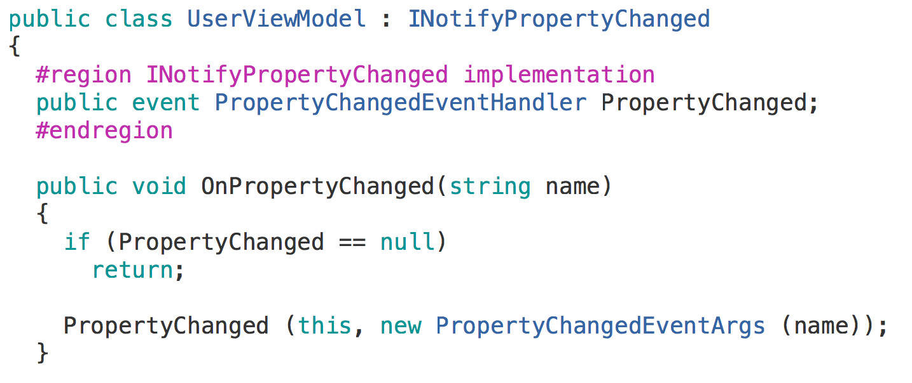
Data Binding

Slide 6
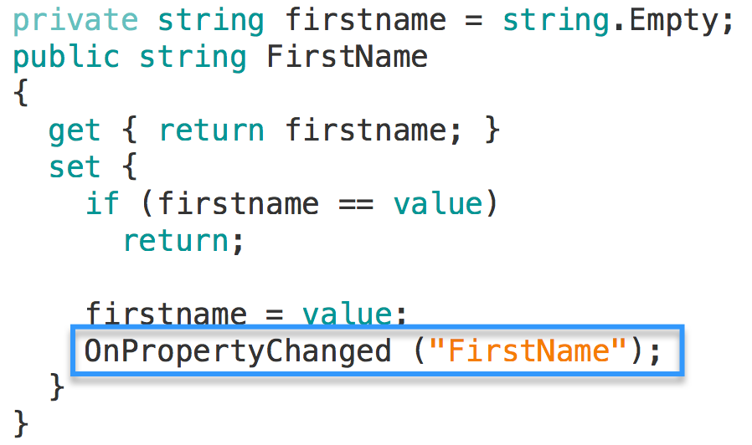
Data Binding

Slide 7
Data Binding

Slide 8
Data Binding

Slide 9

Data Binding – XAML

Slide 10
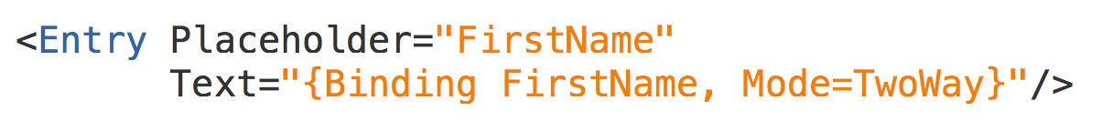
Data Binding – XAML

Slide 11

Event Handling
UI raises events to notify code about user activity
Clicked
ItemSelected
…
The downside is that these events must be handled in the code behind file
Edit
Clicked
public MainPage() { ... Button editButton = ...; editButton.Clicked += OnClick; } void OnClick (object sender, EventArgs e) { ... }

Slide 12
Commands
Microsoft defined the ICommand interface to provide a commanding abstraction for their XAML frameworks
Edit
public interface ICommand { event EventHandler CanExecuteChanged; bool CanExecute(object parameter); void Execute(object parameter); }
Command
CanExecute?
Execute(…)
Can provide an optional parameter (often null) for the command to work with for context

Slide 13
ICommand
ICommand has three required members you must implement
CanExecute is called to determine whether the command is valid, this can enable / disable the control which is bound to the command
public interface ICommand { bool CanExecute(object parameter); void Execute(object parameter); event EventHandler CanExecuteChanged; }

Slide 14
ICommand
ICommand has three required members you must implement
Execute is called to actually run the logic associated with the command when the control is activated – it will only be called if CanExecute returned true
public interface ICommand { bool CanExecute(object parameter); void Execute(object parameter); event EventHandler CanExecuteChanged; }

Slide 15
ICommand
ICommand has three required members you must implement
CanExecuteChanged is an event which the binding will subscribe to, the ViewModel should raise this event when the validity of the command changes
public interface ICommand { bool CanExecute(object parameter); void Execute(object parameter); event EventHandler CanExecuteChanged; }
The binding will then call CanExecute and enable / disable the UI in response

Slide 16




Commands in .NET MAUI
.NET MAUI controls expose a Command property for the main action of a control
Menu
Button
ToolbarItem
TextCell

Slide 17
Commands in .NET MAUI
.NET MAUI controls expose a Command property for the main action of a control
public ICommand GiveBonus { get; }
<Button Text="Give Bonus" Command="{Binding GiveBonus}" />
Can data bind a property of type ICommand to the Command property

Slide 18
Gesture-based commands
.NET MAUI also includes a TapGestureRecognizer which can provide a command interaction for other controls or visuals
<Image Source="IDareYouToTapMe.jpg"> <Image.GestureRecognizers> <TapGestureRecognizer Command="{Binding BeBraveCommand}" CommandParameter="TheyTookTheDare!" /> </Image.GestureRecognizers> </Image>
CommandParameter property supplies the command's parameter – in this case as a string

Slide 19
Using delegate commands
Command<T> and Command provides mechanism to centralize the logic for the commands into the VM
public class EmployeeViewModel : INotifyPropertyChanged { public ICommand GiveBonus { get; private set; } public EmployeeViewModel(Employee model) { GiveBonus = new Command(OnGiveBonus, OnCanGiveBonus); }
void OnGiveBonus() { ... }
bool OnCanGiveBonus() { return ... }
}

Slide 20
Compiled Bindings
.NET MAUI controls expose a x:DataType property that enables compile time checks and optimizations.
<ContentPage x:DataType="viewmodel:EmployeeViewModel">
<Button Text="Give Bonus" Command="{Binding GiveBonus}" />
</ContentPage >

Slide 21
Let’s do it! Part 2 - MVVM

Slide 22
Data Binding Time
<Name>
<Title>
<email>
<website>
@<twitter>
/<YouTube>

Slide 23

20 Minute Break
Weekly development podcast
mergeconflict.fm
James
Montemagno
Principal Lead PM – Developer Community, Microsoft
motz@microsoft.com
montemagno.com
@JamesMontemagno
/JamesMontemagno

